Slide 1

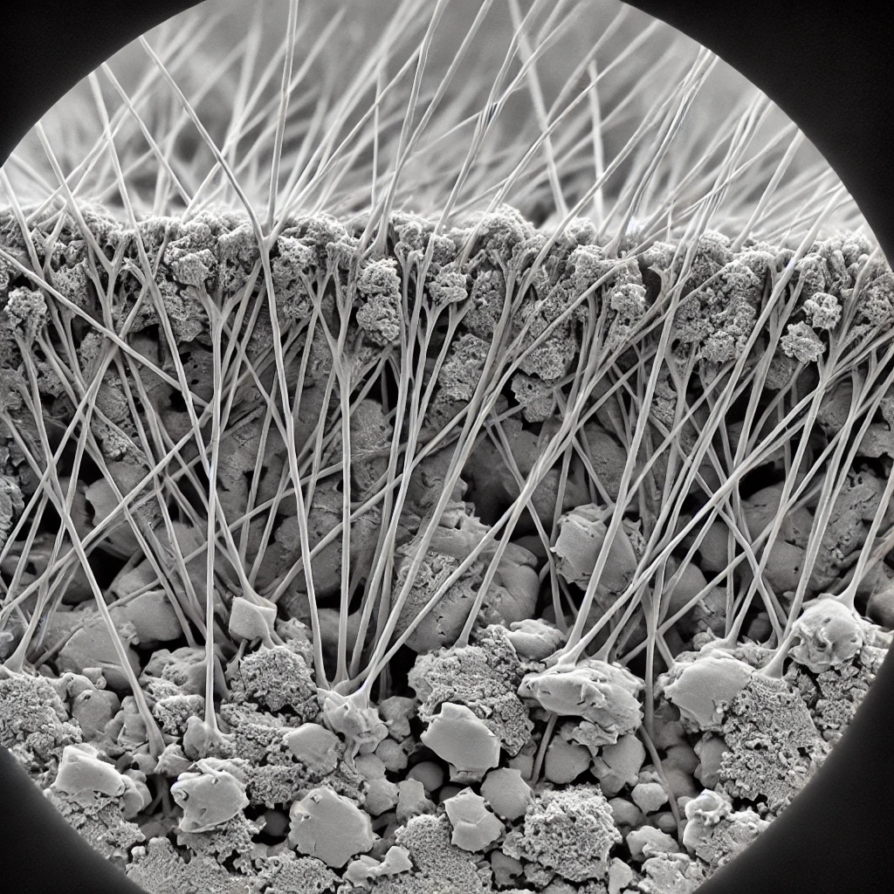
SUSTAINABLE CONCRETE:FIBER REINFORCEMENT
NAME : AJAY PRATAP SINGH
DEPARTMENT OF MECHANICAL ENGINEERING, IIT GUWAHATI
ajay.ps@iitg.ac.in
ROLL NO:230103132
Introduction
Design approach/Methodology
Context and Need : Conventional concrete production is a major source of carbon emissions due to high cement usage, contributing significantly to environmental pollution and climate change.
Traditional concrete often lacks durability and crack resistance, especially under extreme weather or heavy loads, leading to frequent repairs and increased lifecycle costs.
Rationale for Sustainability: Concrete's significant environmental footprint-cement production alone accounts for about 8% of global CO, emissions.
Unique Role of Fibers: Fiber-reinforced concrete not only improves strength but can also reduce the need for large quantities of traditional cement, further lowering carbon emissions.
Global Impact: My study aligns with globally, particularly in sustainable infrastructure.
Innovative Mix Optimization: Used advanced methods (e.g., response surface methodology or machine learning models) for optimizing mix design, targeting a balance between strength, durability, and sustainability.
﻿Experimental Validation: Stress that rigorous, multi-phase testing (e.g., accelerated aging tests) has been conducted to simulate real-world conditions, providing reliable results.
﻿Sustainability Metrics: Quantify sustainability (e.g., lifecycle assessment, reduction in embodied carbon) to show how much more eco-friendly your concrete.
Technical gap and objective.
Result
Limitations of Conventional Concrete:
Low Tensile Strength: Standard concrete has poor resistance to tensile forces, leading to cracking under stress and reducing its lifespan.
Vulnerability to Environmental Damage: Exposure to water, chemicals, and temperature changes can degrade concrete quickly, especially in structures like bridges or coastal buildings.
High Carbon Emissions: Traditional concrete production is energy-intensive and heavily reliant on cement, which contributes significantly to global CO₂ emissions.
Reduced Mechanical Performance: Many sustainable concrete alternatives (using less cement or recycled materials) compromise on strength, making them unsuitable for heavy-load applications without additional reinforcement.
Objective of Fiber Reinforcement:
Strength and Flexibility Enhancement: To create a concrete that maintains high compressive strength while increasing tensile strength and flexibility through fiber reinforcement.
Long-Term Durability: To improve resistance to cracking, moisture penetration, and chemical attack, thereby extending the concrete’s lifespan even in harsh conditions.
Carbon Footprint Reduction: To lower overall carbon emissions by using a mix that requires less cement, with fibers partially replacing traditional materials and reducing the environmental impact.
Minimizing Maintenance Needs: By increasing durability and resistance to damage, fiber-reinforced concrete aims to lower maintenance costs and reduce repair-related carbon emissions.
Key Strength Gains: Show a quantified increase in strength (e.g., "Fiber-reinforced concrete is 30% stronger than non-reinforced sustainable concrete").
﻿﻿Durability Enhancement: Fiber reinforcement reduced cracking by X% under extreme conditions.
Strength Improvements: Show increases in compressive and tensile strength with fiber reinforcement compared to standard sustainable concrete.
Conclusion
﻿﻿Real-World Benefits: It decrease the frequency of repairs and increase the lifespan of sustainable concrete structures, making it a practical choice for public infrastructure.
Scalability Potential: Its adaptability across various climates and environments, from humid coastal areas to dry interiors.
﻿﻿Future Vision: This innovation could pave the way for future smart concretes-using fibers as conduits for self-monitoring or self-healing capabilities.
Fiber reinforcement in sustainable concrete significantly improves its mechanical properties and durability.
﻿﻿Environmental Impact: By using eco-friendly materials, the solution offers a greener, more resilient alternative to traditional concrete.
﻿﻿Future Work: Suggest further studies on optimizing fiber types or sustainable additives for specific structural.
Proposed solution
Multifunctional Fiber Reinforcement: Fibers (e.g., bio-based, synthetic) provide both structural integrity and potential insulation, adding energy efficiency benefits.
Environmental Impact Reduction: Fiber-reinforced concrete could reduce repair needs, lowering maintenance emissions and costs over a building's lifecycle.
Fibers improve the strength of concrete through these key mechanisms:
Crack Bridging
Load Redistribution
Enhanced Tensile Strength
Energy Absorption
Fiber reinforcement helps reduce carbon emissions in concrete through the following ways:
Extended Durability:
Reduced Cement Content:
Lowered Embodied Carbon:
Decreased Maintenance and Repair Emissions:
References
National Academy of Sciences: Transportation Research Board 2021 Article reuse guidelines:
Corresponding Author:
Wengui Li, Wengui.li@uts.edu.au
RESEARCH ARTICLE : Transportation research.
journal homepage: www.journals.elsevier.com/powder-technology
Acknowledgement
• I would like to express my sincere gratitude to the Department of Mechanical Engineering at IITG for providing the resources and guidance essential for this project. Special thanks to Professor(S.Kanagaraj Sir) for their invaluable mentorship and insights into sustainable material science, which have greatly enhanced my understanding and approach to this study.

